Slide 1
Chapter 10 (part 1)
Independent t-tests

Slide 2
Aims
t-tests
  Independent (Between-Subjects)
  Dependent (paired-samples, matched-pairs) (Next week!)
Rationale for the t-test
  Assumptions
Interpretation
Reporting results
Calculating an effect size

Slide 3
Experiments (1)
The simplest form of experiment that can be done is one with only one independent variable (IV) that is manipulated in only two ways, and only one outcome is measured.
Usually the manipulation of the IV involves having an experimental condition and a control condition.
Changes in dependent variable (DV) are measured between groups

Slide 4
Experiments (2)
Example:
  E.g., Is the movie Scream 2 scarier than the original Scream?
  Independent variable?
  How to measure scariness?
    We could measure heart rates (which indicate anxiety) during both films and compare them.
How to analyze? a t-test!

Slide 5
t-test
Independent t-test
  Compares two means based on independent data
  E.g. data from different groups of people.

Slide 6
Cloaks of Invisibility (1)
Are invisible people mischievous?
  24 participants
Manipulation
  Placed participants in an enclosed community riddled with hidden cameras.
  12 participants were given an invisibility cloak.
  12 participants were not given an invisibility cloak.
Outcome
  measured how many mischievous acts participants performed in a week.

Slide 7
Cloaks of Invisibility (2)
Hypotheses:
  H₀: Invisible and visible people will conduct the same number of mischievous acts
    M₁ = M₂
  H₁: Invisible people will conduct more mischievous acts
    M₁ > M₂

Slide 8
Cloaks of Invisibility (3)
Participant | Cloak | Mischievous Acts
1 | Yes | 10
2 | Yes | 7
3 | Yes | 9
4 | Yes | 12
5 | Yes | 5
6 | Yes | 8
7 | Yes | 11
8 | Yes | 6
9 | Yes | 14
10 | Yes | 7
11 | Yes | 9
12 | Yes | 8
13 | No | 3
14 | No | 2
15 | No | 5
16 | No | 6
17 | No | 4
18 | No | 7
19 | No | 3
20 | No | 5
21 | No | 2
22 | No | 6
23 | No | 4
24 | No | 5
Notes:
IV? DV? Groups? Independent or dependent?

Slide 9
Cloaks of Invisibility (4)
Summary statistics
Group | N | Mean | S
Cloak = Yes | 12 | 8.4 | 2.7
Cloak = No | 12 | 4.3 | 1.6
Notes:
IV? DV? Groups? Independent or dependent?

Slide 10
Rational for the t-test (1 of 3)
Two samples are collected and the means calculated.
  These means might differ by either a little or a lot.
If the samples come from the same population, large differences between samples should be rare
Under the null hypothesis, we expect means from two random samples to be very similar (H₀)
A large mean difference would likely be due to our manipulation (H₁)

Slide 11
Rational for the t-test (2 of 3)
We compare the difference between the sample means that we collected to the difference we would expect If there were no effect.
If observed > (or <) expected than we would expect based on the standard error, then one of two things has happened:
  There is no effect but sample means from our population fluctuate a lot and we happen to have collected two samples that produce very different means.
  This difference indicates a genuine difference between the samples. In other words, the null hypothesis is unlikely.

Slide 12
Rational for the t-test (3 of 3)
The larger the observed difference between the sample means (relative to the standard error), the more likely it is that the two sample means differ because of the different testing conditions imposed on each sample.
AKA the more confidence we have that our manipulation produced the difference

Slide 13
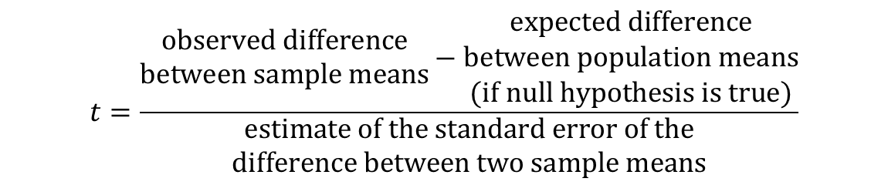
Rationale of the t-test
$$t=\frac{\begin{matrix}\text{observed} \text{difference} \\ \text{between} \text{sample} \text{means}\end{matrix}−\begin{matrix}\text{expected} \text{difference} \\ \text{between} \text{population} \text{means} \\ \text{(}\text{if} \text{null} \text{hypothesis} \text{is} \text{true}\text{)}\end{matrix}}{\begin{matrix}\text{estimate} \text{of} \text{the} \text{standard} \text{error} \text{of} \text{the} \\ \text{difference} \text{between} \text{two} \text{sample} \text{means}\end{matrix}}$$

Slide 14
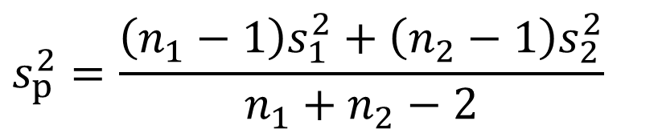
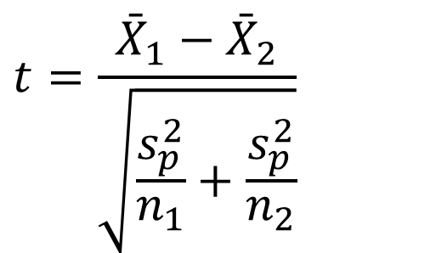
The Independent t-test
$$t=\frac{{\bar{X}}_{1}−{\bar{X}}_{2}}{\sqrt{\frac{s_{p}^{2}}{n_{1}}+\frac{s_{p}^{2}}{n_{2}}}}$$
$$s_{p}^{2}=\frac{\left(n_{1}−1\right)s_{1}^{2}+\left(n_{2}−1\right)s_{2}^{2}}{n_{1}+n_{2}−2}$$

Slide 15
Cloaks of Invisibility (4)
Summary statistics
Group | N | Mean | S
Cloak = Yes | 12 | 8.4 | 2.7
Cloak = No | 12 | 4.3 | 1.6
Notes:
IV? DV? Groups? Independent or dependent?

Slide 16
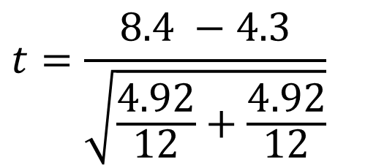
Cloaks of Invisibility (5)
$$t=\frac{8.4 −4.3}{\sqrt{\frac{4.92}{12}+\frac{4.92}{12}}}$$
Notes:
IV? DV? Groups? Independent or dependent?

Slide 17
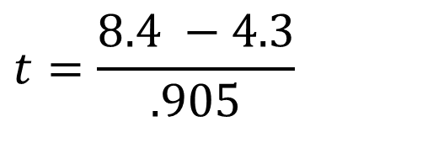
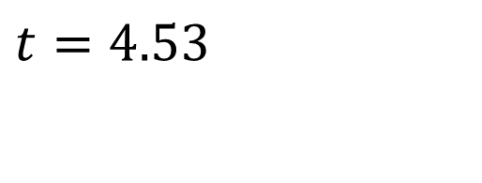
Cloaks of Invisibility (6)
Difference between sample means
$$t=\frac{8.4 −4.3}{.905}$$
Standard Error (SE)
$$t=4.53$$
Notes:
IV? DV? Groups? Independent or dependent?

Slide 18
t-tests and significance (1)
What exactly is t?
  t is a test statistic
  A test statistic is a single numerical value calculated from your sample data during hypothesis testing
  Summarizes how much your observed data deviates from what you'd expect under the null hypothesis.
  The larger (or more extreme) this value, the stronger the evidence against the null hypothesis.

Slide 19
t-tests and significance (2)
Test statistics are normed
The probability of obtaining a specific t-value can be determined using the t-distribution
Things you need:
  Alpha (significance level)
  Number of tails (usually 2)
  DF (degrees of freedom – n – 2 for an independent t-test)

Slide 20
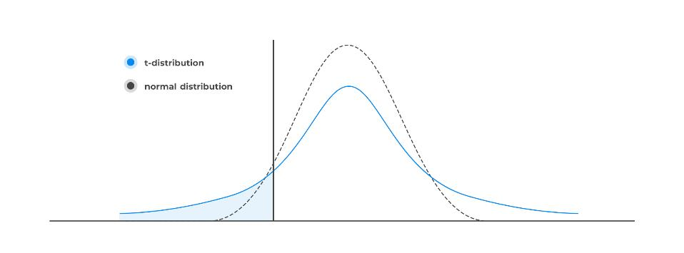
t-distribution

Slide 21
t-tests and significance (3)
t-table (use to look up the critical t-test statistic)
  Compare your t to critical t-value (in table). If larger, significant difference!
t-probability table (used to find probability of your t-value)
Values you need:
  Calculated t
  Alpha (significance level)
  Number of tails (usually 2)
  DF (degrees of freedom – n – 2 for an independent t-test)

Slide 22
The Data
Summary statistics
Group | N | Mean | S
Cloak = Yes | 12 | 8.4 | 2.7
Cloak = No | 12 | 4.3 | 1.6
df = 22; t = 4.53
Notes:
IV? DV? Groups? Independent or dependent?

Slide 23
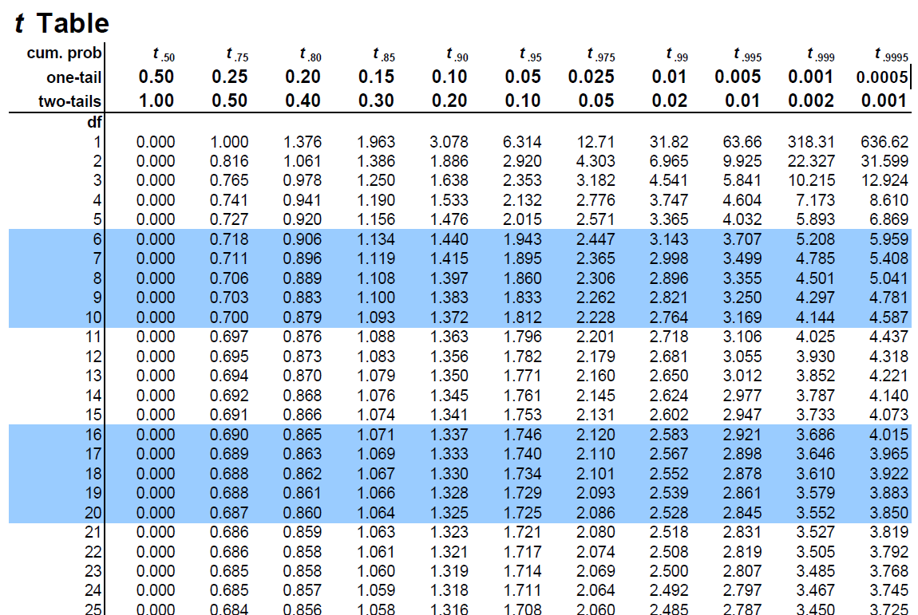
Get critical t from t-table
Notes:
Finding Critical t: One tailed test (direction), use an alpha of .05

Slide 24
Estimate p-value
Notes:
Since t = 4.53 > 3.792, and 3.792 corresponds to α = 0.0005 (one-tailed), p-value is smaller than .0005

Slide 25
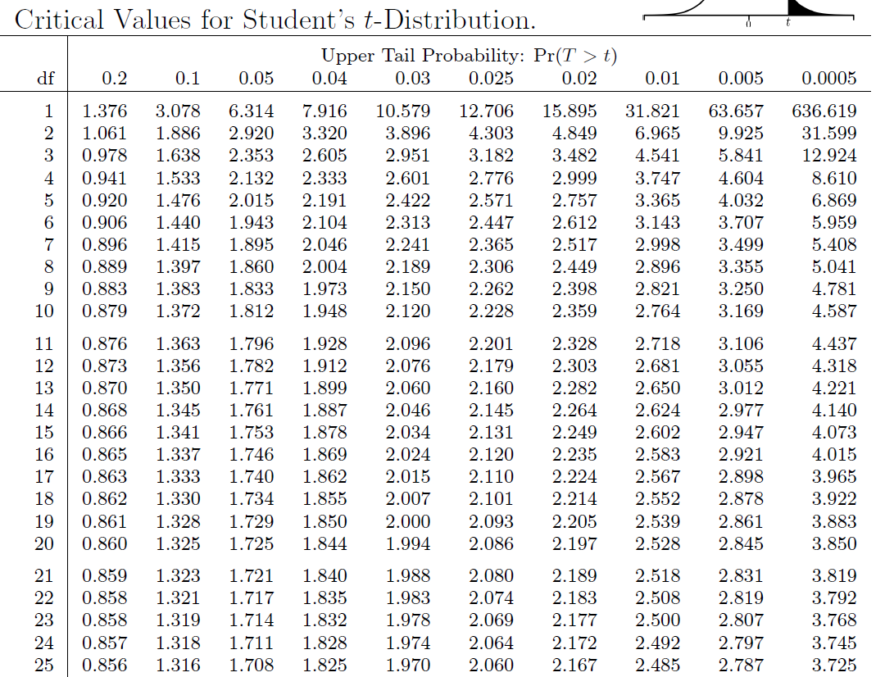
t-probability table
p < .001

Slide 26
Assumptions of the t-test (1 of 2)
t-tests are parametric tests based on the normal distribution. Therefore, they assume:
  The sampling distribution is normally distributed. In the dependent t­-test this means that the sampling distribution of the differences between scores should be normal, not the scores themselves.
  Data are measured at least at the interval level.

Slide 27
Assumptions of the t-test (2 of 2)
The independent t-test, because it is used to test different groups of people, also assumes:
  Variances in these populations are roughly equal (homogeneity of variance).
  Scores in different treatment conditions are independent (because they come from different people).

Slide 28
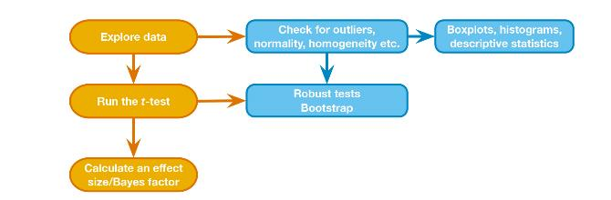
t-test General Process

Slide 29
Effect Sizes (1)
Effect sizes quantify the magnitude of a difference or relationship between groups or variables.
Provides context to statistical significance, answering the question: "How large is the observed effect?"
Complement p-values! While a p-value indicates whether an effect exists, the effect size tells us how substantial that effect is.

Slide 30
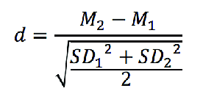
Effect Sizes (2)
Common effect size for t-tests: Cohen’s d
  Measures the standardized difference between two means.
Independent samples

Slide 31
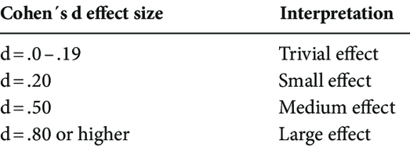
Effect Sizes (3)

Slide 32
Reporting the t-test
On average, participants given a cloak of invisibility engaged in more acts of mischief (M = 8.4, SD = 2.7), than those not given a cloak (M = 4.3, SD = 1.6). This difference was significant, t(22) = 4.53, p < .001 and represented a large-sized effect (d = 0.83).

